Slide 1
Business and Ethical Relativism
Business Ethics and Corporate Social Responsibility
Shareholder view/Theory
Stakeholder view/ Theory

Slide 2
Business and Ethical Relativism
There are certain cultural differences that create a special problem for managers. Managers of multinationals often find it hard to know what to do when they encounter moral standards that are different from the ones they personally hold and that are accepted in their home country.
Nepotism and sexism, although condemned as morally wrong in the United States, for example, are accepted as a matter of course in some foreign business environments.
The fact that different cultures have different moral standards, leads many people to adopt the theory of ethical relativism.

Slide 3
Ethical or moral relativism
The theory that there are no ethical standards that are absolutely true and that apply or should be applied to the companies and people of all societies.
The ethical relativist will say, for example, that it is wrong for a U.S. manager to engage in nepotism in the United States because everyone there believes that it is wrong, but it is not wrong for a person in Thailand, for example, to engage in nepotism there because people there do not see it as wrong.
The ethical relativist would advise the manager of a multinational who works in a society whose moral standards are different from her own, that she should follow the moral standards prevalent in the society in which she works.

Slide 4
Since moral standards differ and since there are no absolute standards of right and wrong, the best a manager can do is follow the old saying, “When in Rome, do as the Romans do.” But is ethical relativism a reasonable view to hold?
Discussion from pdf

Slide 5
Business Ethics and Corporate Social Responsibility
Business ethics is sometimes confused with “corporate social responsibility” or “CSR.”
The phrase “corporate social responsibility” refers to a corporation’s responsibilities or obligations toward society.

Slide 6
There is some disagreement about what those obligations include.
Do companies have a responsibility to donate to charities or to give their employees higher wages and customers safer products?
Or are they obligated to maximize profits for their shareholders or stockholders?

Slide 7
Shareholder view/Theory
At one extreme is the view of the late economist Milton Friedman. Friedman argues that in a “free enterprise, private-property system,” corporate executives work for the “owners” of the company, and today these “owners” are the company’s shareholders. As their employee, the executive has a “direct responsibility” to run the company “in accordance with their desires, which generally will be to make as much money as possible while conforming to the basic rules of the society, both those embodied in law and those embodied in ethical custom.”
On Friedman’s view a company’s only responsibility is to legally and ethically “make as much money as possible” for its owners, i.e., to maximize shareholder returns. We can call his view the “shareholder view” of corporate social responsibility.

Slide 8
The main reason why Friedman holds this theory is that, in his view, shareholders own the company. Since the company is their, and only their, property, only they have the moral right to decide what it should be used for. These “owners” hire executives to run the business for them, so the executives have a moral obligation to do what the stockholders want, which, he claims, is to make them as much money as possible.
According to Friedman’s shareholder view of corporate social responsibility, a manager has no right to give company money to social causes when doing so will reduce shareholder’s profits, because that money does not belong to the manager but to shareholders.

Slide 9
For example, higher wages might make employees work harder, better products may increase customer sales, and giving to the local community may lead to lower taxes or better city services. But if using company resources to benefit employees, customers, or the community reduces the profits that would have gone to shareholders, then doing so is wrong because those resources belong to stockholders and should be used as they want them to be used, i.e., to make them more money. It is always wrong for managers to use company resources to help others at the expense of shareholders.

Slide 10
Although Friedman does not think managers should use company resources to benefit others at the expense of shareholders, he does think that companies ultimately provide great benefits for society.
So when managers aim at maximizing profits for stockholders in competitive markets, the companies they run will end up benefiting society.

Slide 11
Criticism
Friedman has had many critics.
Some object to his claim that the manager or executive is the employee of shareholders. Legally, these critics point out, the executive is the employee of the corporation and so the executive is legally required to serve the interests of the corporation—his true employer—not of its shareholders.

Slide 12
Criticism (Contd.)
Others have criticized Friedman’s claim that stockholders are the “owners” of the corporation and that the corporation is their “property.”
Critics point out that shareholders only own stock and this gives them a few limited rights, such as the right to elect the board of directors, the right to vote on major company decisions, and the right to whatever remains after the corporation goes bankrupt and pays off its creditors. But shareholders do not have all the other rights that true owners would have and so they are not really owners of the corporation.

Slide 13
Criticism (Contd.)
Third objection criticizes his claim that the executive’s core responsibility is to run the corporation as stockholders want it to be run.
Legally, the executive, is required to run the company in ways that serve many other interests (including employee interests and consumer interests) besides those of stockholders.

Slide 14
Criticism (Contd.)
Finally, some have argued against Friedman’s view that by seeking to maximize shareholder returns, the corporation will best serve society.
Sometimes competitive forces fail to operate companies in a socially beneficial way and, instead, lead them to act in a socially harmful manner. For example, a company might knowingly pollute a neighborhood with substance that is not yet illegal, in order to save the costs of reducing its pollution and thereby be more competitive.

Slide 15
Stakeholder view/ Theory
According to Edward Freeman and David Reed, the two scholars who pioneered this view, a stakeholder is “any identifiable group or individual who can affect the achievement of an organization’s objectives or who is affected by the achievement of an organization’s objectives.”

Slide 16
In other words, a stakeholder is anyone the corporation can harm, benefit, or influence,
as well as anyone that can harm, benefit, or influence the corporation.
A stakeholder, in short, is anyone who has a “stake” in what the company does.

Slide 17
For example,
General Motors impacts the lives of its customers when it decides how much safety it will build into its cars,
it impacts employees when it sets salaries,
it impacts the local community when it shuts down a plant,
and it impacts its stockholders when it increases their dividends.
On the other hand, government can impact General Motors through the laws and regulations it passes,

Slide 18
Creditors can impact it by raising their interest rates or calling back a loan, and suppliers can impact it by raising their prices or lowering the quality of the car parts they provide.
General Motors’ stakeholders, then, include customers, employees, local communities, stockholders, government, creditors, and suppliers.
BUT
Of course, the influences between the company and its stakeholders can go both ways.

Slide 19
For example,
Although General Motors influences its customers and employees, customers can also influence General Motors by refusing to buy its cars and employees can impact General Motors by going on strike.
Other groups also are sometimes able to influence General Motors. For example, environmental activists or the media can impact General Motors by organizing demonstrations or by reporting on a safety defect of General Motors’ cars.
Thus, activist organizations, the media, and other interest groups can also become stakeholders of General Motors.

Slide 20
Unlike Friedman’s shareholder view, which says the corporation should be run for the benefit only of its shareholders, “stakeholder theory” says it should be run for the benefit of all stakeholders.

Slide 21
According to stakeholder theory, a manager should take all stakeholder interests into account when making decisions.
Managers should try to “balance” the interests of stakeholders so each stakeholder gets a fair share of the benefits the corporation produces.
The manager, then, has the responsibility of running the company in a way that will best serve the interests of all stakeholders.

Slide 22
The stakeholder theory does not claim that managers should not try to make a profit; it does not even claim that managers should not try to maximize profits.
The claims of stakeholder theory are about who should get the profits.
Friedman’s shareholder view says that the manager should try to maximize what goes to the stockholder, which means it should try to minimize what goes to other stakeholders (except, of course, when giving some stakeholders more would make even more profits for stockholders).

Slide 23
Stakeholder theory, on the other hand, says that the manager should give stockholders a fair share of profits, but in a way that allows all other stakeholders to also get their fair share.
Two main kinds of arguments support the “stakeholder” view of corporate social responsibility:
“instrumental” arguments
and “normative” arguments.

Slide 24
Instrumental Arguments
Instrumental arguments claim that being responsive to all of its stakeholders is in the best interests of the corporation even though it may not be in the best interests of shareholders.
The idea here is that if a company takes the interests of all its stakeholders into account, those stakeholders will be favorably disposed to do their part to support the company and its interests.

Slide 25
Treating employees decently while paying them good salaries, for example, will make employees more loyal to the company, while treating them poorly may lead to shirking or even destructive behavior.
Similarly, when a company is responsive to environmentalists or other activists, these groups are less likely to engage in activities that can damage the company’s image or its reputation.

Slide 26
Yet paying employees higher wages and investing in meeting environmentalists’ demands may force a company to reduce shareholder dividends.
In short, instrumental arguments for stakeholder theory claim that being responsive to all stakeholders is good for the business even though it may reduce the profits shareholders end up with.

Slide 27
Normative Arguments
Normative arguments for stakeholder theory claim that the company has a moral or ethical obligation to be responsive to all its stakeholders. One such argument, developed by Robert Phillips, is based on the “principle of fairness.”
The principle of fairness says that if a group of people works together to provide some benefits at some cost to themselves, then anyone who takes advantage of those benefits has an obligation to contribute his or her share to the group.

Slide 28
Which of these two views is correct:
stakeholder theory or shareholder theory?
Today, many businesses accept stakeholder theory, and most of the fifty U.S. states have passed laws that recognize business’ obligations to its many stakeholders even at the expense of stockholder interests.
But readers will have to decide for themselves which theory makes the most sense and seems most reasonable.

Slide 29
How are business ethics and corporate social responsibility related?
Being ethical, according to most scholars, is one of the obligations companies owe to society.
In this respect, business ethics is a part of corporate social responsibility.
Archie Carroll writes: “The social responsibility of business encompasses the economic, legal, ethical, and discretionary expectations that society has of organizations . . . ”
Corporate social responsibility, then, is the larger more inclusive notion and business ethics is just one part of this larger notion.

Slide 30
Both the shareholder view and the stakeholder view can accept this way of defining what corporate social responsibility includes.
For example, Friedman explicitly says that a company should live up to the ethical and legal expectations of society, that by pursuing shareholder profits it will make the greatest economic contribution to society, and that it should make whatever other discretionary contributions it needs to make so that society will enable it to operate profitably.

Slide 31
Stakeholder theory says that companies should be responsive to all its stakeholders and that would include making the economic and discretionary contributions society expects, as well as behaving ethically and legally toward its stakeholders.
All of these concepts—rights, obligations, and fairness—are ethical concepts so ethics is not only part of a company’s social responsibilities. Ethics also provides the basic normative reasons for corporate social responsibility. Paradoxically, then, ethics is one of business’ social responsibilities, but business has these responsibilities to society because it is what ethics demands.

Slide 32
WHAT IS CORPORATE SOCIAL RESPONSIBILITY (CSR)?
Corporate social responsibility (CSR) is the idea that a business has a responsibility to the society that exists around it.
Firms that embrace corporate social responsibility are typically organized in a manner that empowers them to be and act in a socially responsible way to have a positive impact on the world. It’s a form of self-regulation that can be expressed in initiatives or strategies, depending on an organization’s goals.

Slide 33
TYPES OF CORPORATE SOCIAL RESPONSIBILITY
Along with the responsibility towards owners, managers, customers and employees, firms also have some social responsibilities which may include:
environmental, philanthropic, ethical, and economic responsibility.

Slide 34
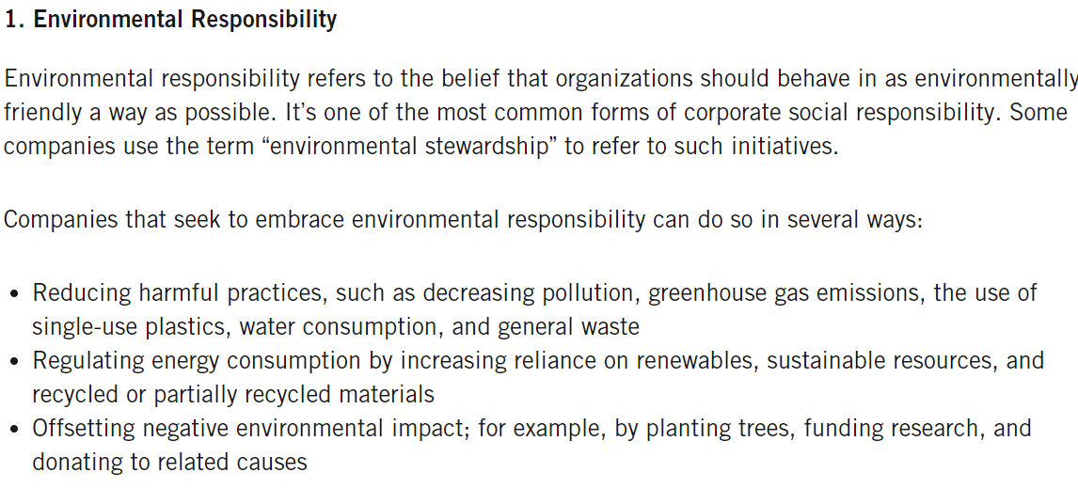

Slide 35
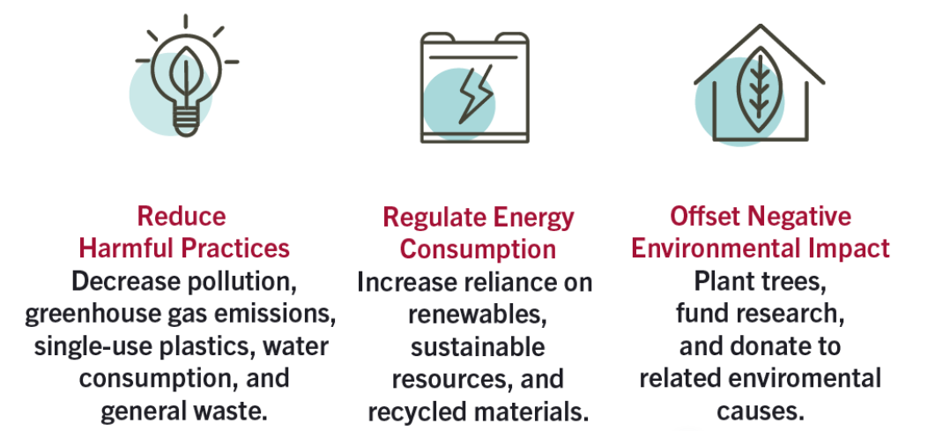

Slide 36
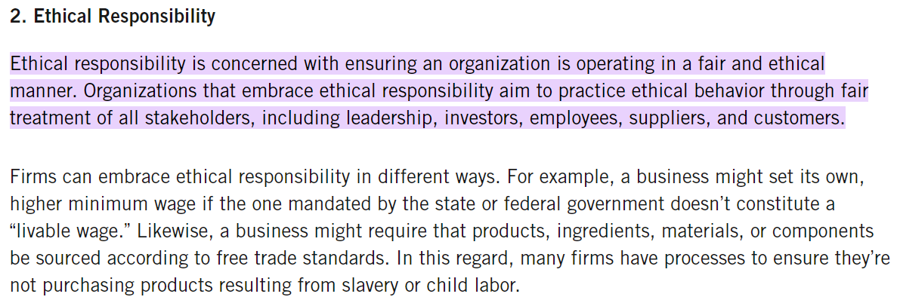

Slide 37
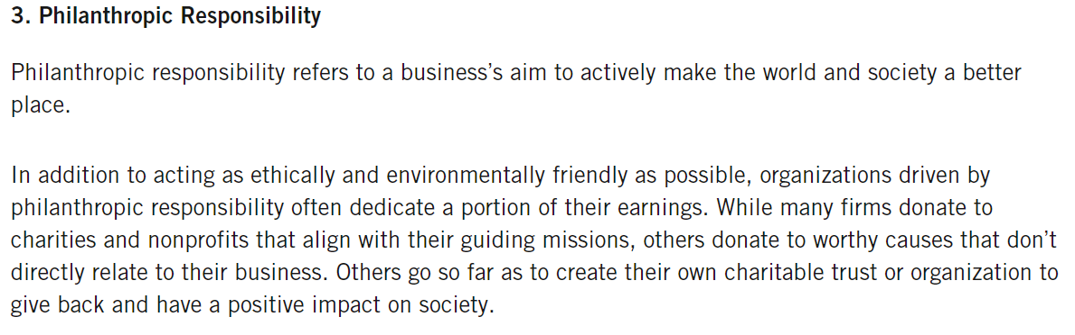

Slide 38
